Slide 1
Group 8
Member 1:
Name : Shad Al kaisar
Id: 1721392042
Member 2 :
Name : Ashraful Kalam Abid
Id : 1721464042

Slide 2
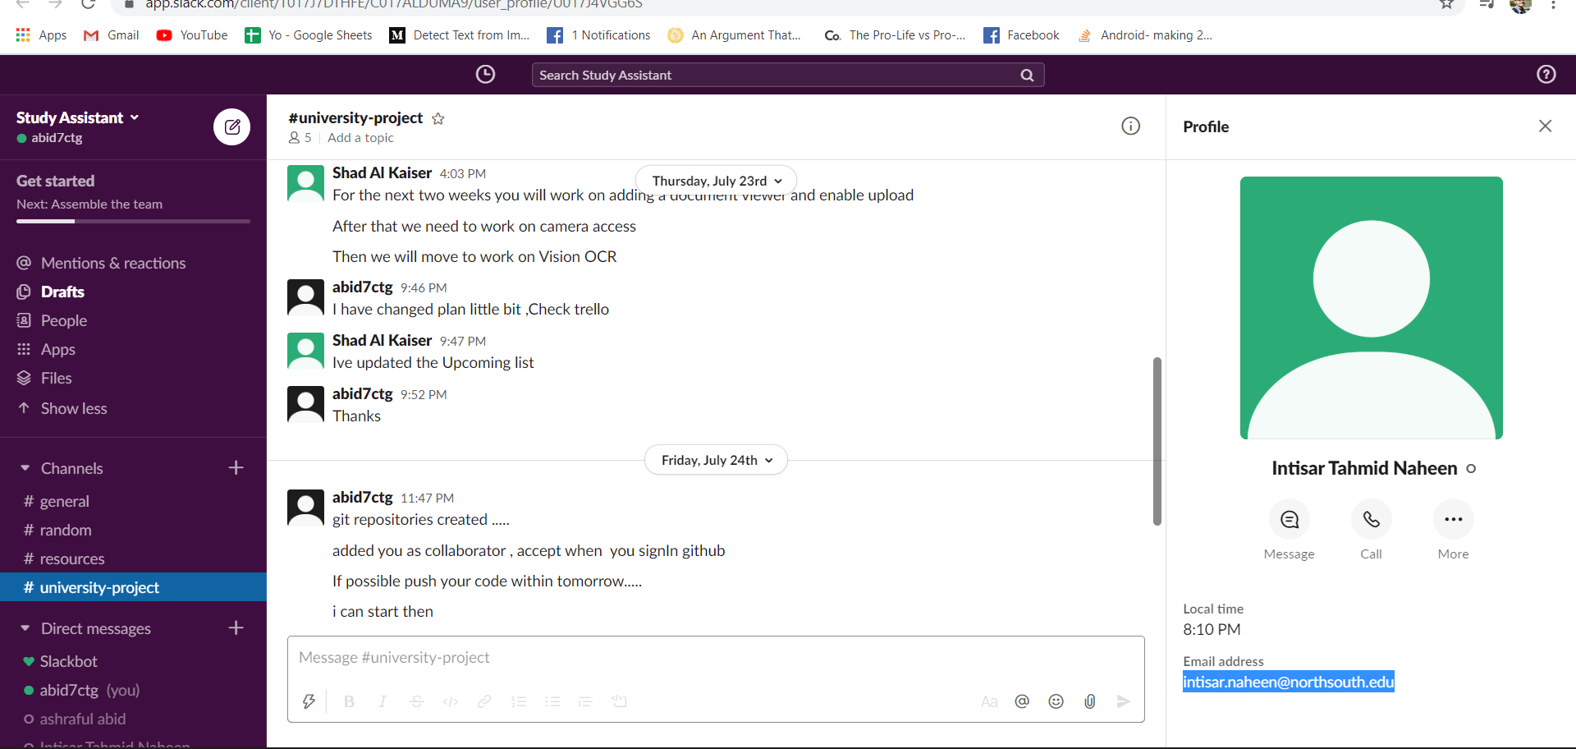
Slack workspace link : https://app.slack.com/client/T017J7DTHFE/C017ALDUMA9/user_profile/U017J4VGG6S

Slide 3
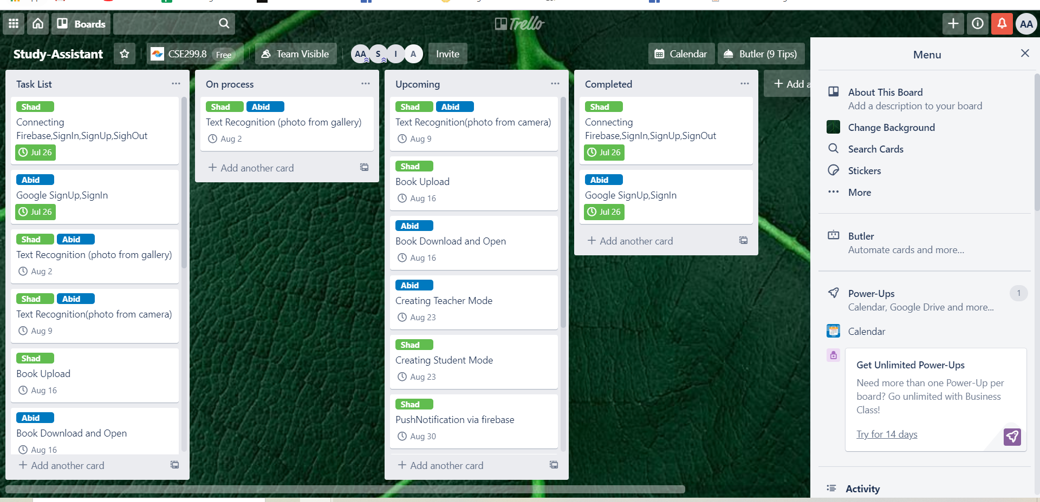
Trello Link :
https://trello.com/b/R7Jf8uqt/study-assistant

Slide 4
Git Link:
https://github.com/Ashraf-Abid/cse299

Slide 5
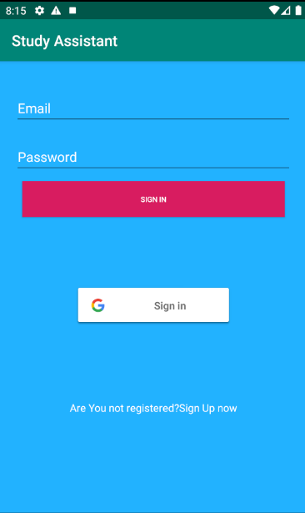
Apps screenshot

Slide 6
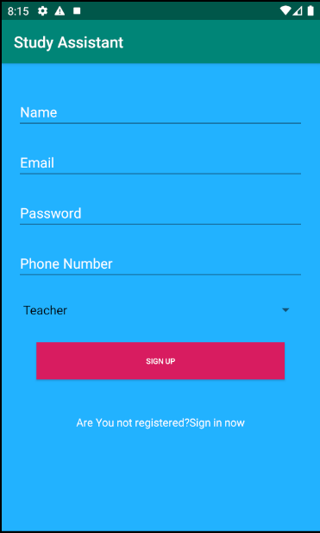

Slide 7
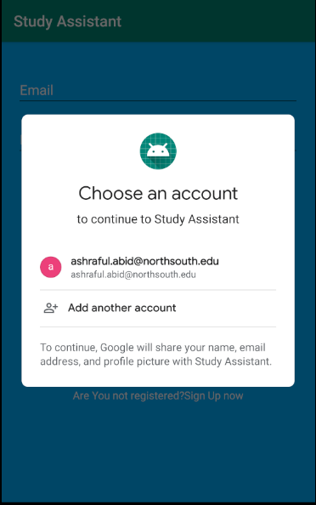

Slide 8
